Slide 1
Java – Phase 1
Upskilling
Core Java
Diwahar Sundar
Satesh Kumar Hariharan
January 09, 2023.

Slide 2
Curriculum
Introduction
Oops & Loops
Collections Framework
Comparators & Exception Handing
Java Functional Streams
Design Patterns

Slide 3
09-Jan-2023
Introduction
Oops & Loops
Collections Framework
Comparators & Exception Handing
Java Functional Streams
Design Patterns
History
JVM – JDK – JRE
Installation
Executing “Hello World”
Datatypes
Classes
Objects
Functions

Slide 4
Brief History
Inception: Java programming language was originally developed by Sun Microsystems which was initiated by James Gosling and released in 1995 as core component of Sun Microsystems' Java platform.
Platform Independent − Unlike many other programming languages including C and C++, when Java is compiled, it is not compiled into platform specific machine, rather into platform independent byte code. This byte code is distributed over the web and interpreted by the Virtual Machine (JVM) on whichever platform it is being run on.
High Performance − With the use of Just-In-Time compilers, Java enables high performance.
Distributed − Java is designed for the distributed environment of the internet.
Dynamic − Java is more dynamic than C or C++ since it is designed to adapt to an evolving environment. Java programs can carry extensive amount of run-time information that can be used to verify and resolve accesses to objects on run-time.
WORA - Sun released the first public implementation as Java 1.0 in 1995. It promised Write Once, Run Anywhere (WORA), providing no-cost run-times on popular platforms.

Slide 5
JVM – JDK - JRE
Java Development Kit (JDK) is a software development environment used for developing Java applications and applets. It includes the Java Runtime Environment (JRE), an interpreter/loader (Java), a compiler (javac), an archiver (jar), a documentation generator (Javadoc), and other tools needed in Java development.
Java Runtime Environment provides the minimum requirements for executing a Java application; it consists of the Java Virtual Machine (JVM), core classes, and supporting files.
JVM (Java Virtual Machine) is a very important part of both JDK and JRE because it is contained or inbuilt in both. Whatever Java program you run using JRE or JDK goes into JVM and JVM is responsible for executing the java program line by line, hence it is also known as an interpreter. Runtime Instance Whenever you write a java command on the command prompt to run the java class, an instance of JVM is created.

Slide 6
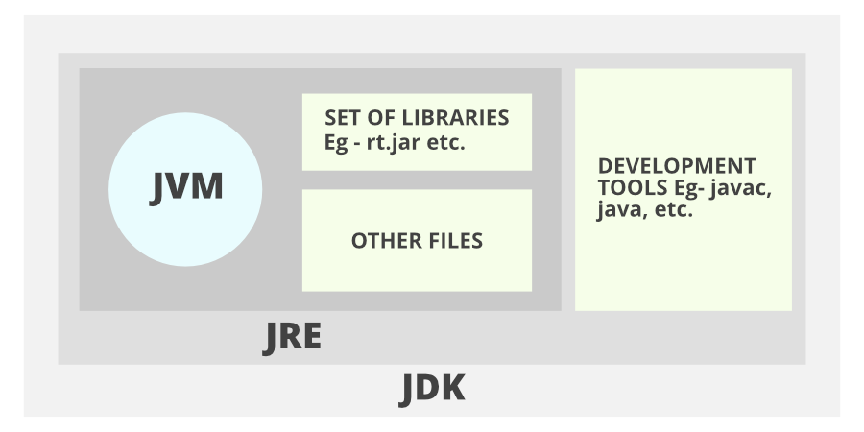
JDK Architecture

Slide 7
Java Installation
Download JDK 11 from https://www.oracle.com/in/java/technologies/javase/jdk11-archive-downloads.html.
Set JAVA_HOME Env Path to ‘C:\Program Files\Java\jdk-11.0.13’.
Check the java version by using the command ‘java --version’ in cmd prompt.
Download Eclipse from https://www.eclipse.org/downloads/
Run the eclipse installer.

Slide 8
Running Your First Program
Create a class file ‘FirstClass.java’ using a notepad and have the main method declared.
Print “Hello World” inside the main method.
Save the file
Compile using ‘javac <<FileName(.java)>>’ i.e., ‘javac FirstClass.java’ command.
Run the program using ‘java <ClassName>’ i.e., ‘java FirstClass’.

Slide 9
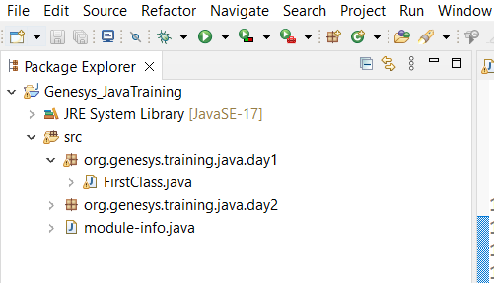
Project Structure
Create a Java Project using File -> New -> Java Project.
Give a name to the project and eclipse creates a project for you.
Create a package under the src folder. Please note that all the java code goes inside the src folder.
The package is used to group a list of java files together.
Right click on the package and create a java file.

Slide 10
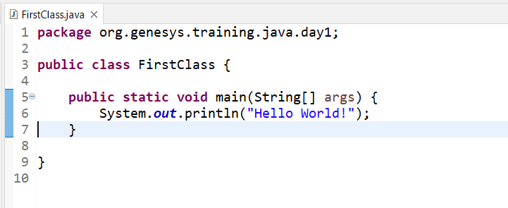
Main Method
public: It is an access specifier. We should use a public keyword before the main() method so that JVM can identify the execution point of the program. If we use private, protected, and default before the main() method, it will not be visible to JVM.
Static: You can make a method static by using the keyword static. We should call the main() method without creating an object. Static methods are the method which invokes without creating the objects, so we do not need any object to call the main() method.

Slide 11
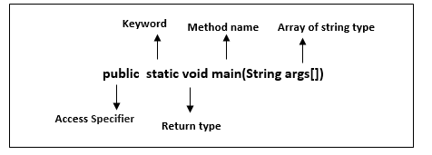
Main Method Breakdown
void: In Java, every method has the return type. Void keyword acknowledges the compiler that main() method does not return any value.
main(): It is a default signature which is predefined in the JVM. It is called by JVM to execute a program line by line and end the execution after completion of this method. We can also overload the main() method.

Slide 12
Data Types - Primitives
byte
short
int
long
float
double
boolean
char

Slide 13
Primitive Data Types – Memory
Data Type | Description | Default Value | Memory Size
boolean | A binary value of either true or false | false | 1 bit
char | Any Unicode character | \u0000 (0) | 16-bit Unicode character
byte | Values from -128 to 127 | 0 | 8-bit signed value
short | Values from -32768 to 32767 | 0 | 16-bit signed value
int | Values from -2³¹ to 2³¹-1 | 0 | 32-bit signed value
long | Values from -2⁶³ to 2⁶³-1 | 0 | 64-bit signed value
float | IEEE 754 floating point | 0.0 | 32-bit floating-point value
double | IEEE 754 floating point | 0.0 | 64-bit floating-point value

Slide 14
String
String is a Class in java.
String is immutable i.e., when we create a string, its value never changes within the constant pool.
There are two ways to create a string in java.
  String name = “abc”;
  String name = new String(“name”);

Slide 15
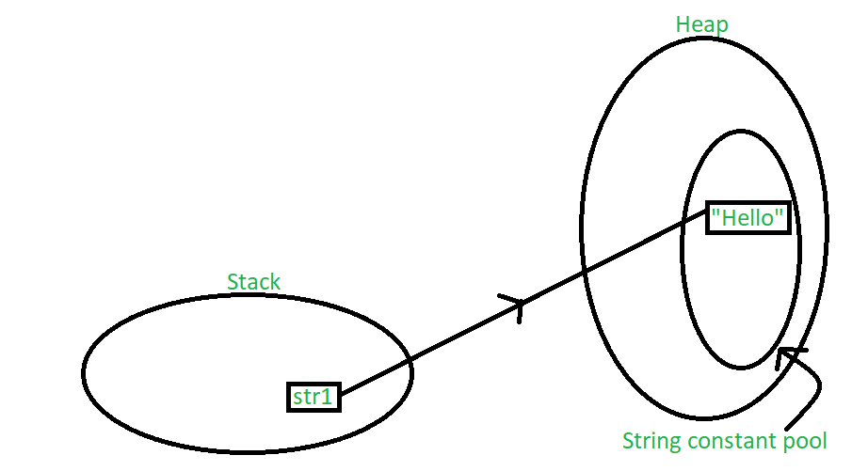
String
String str1 = “Hello”;

Slide 16
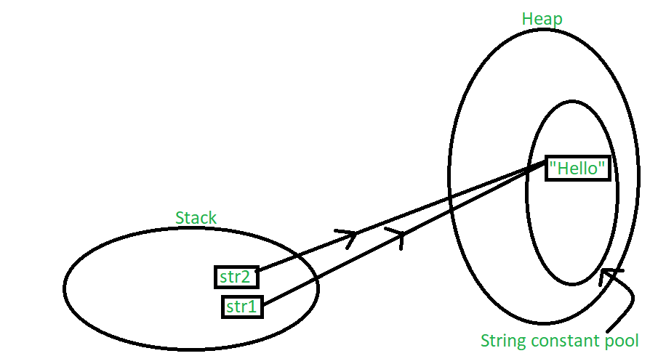
String
String str1 = “Hello”;
String str2 = “Hello”;

Slide 17
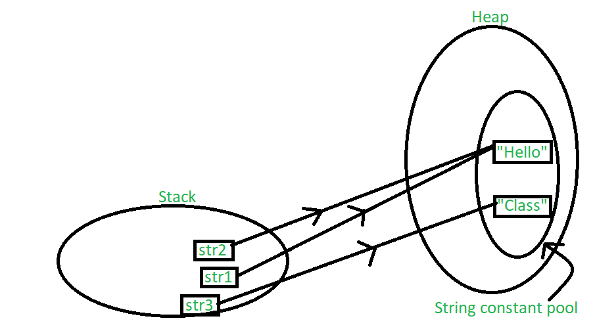
String
String str1 = “Hello”;
String str2 = “Hello”;
String str3 = “Class”;

Slide 18
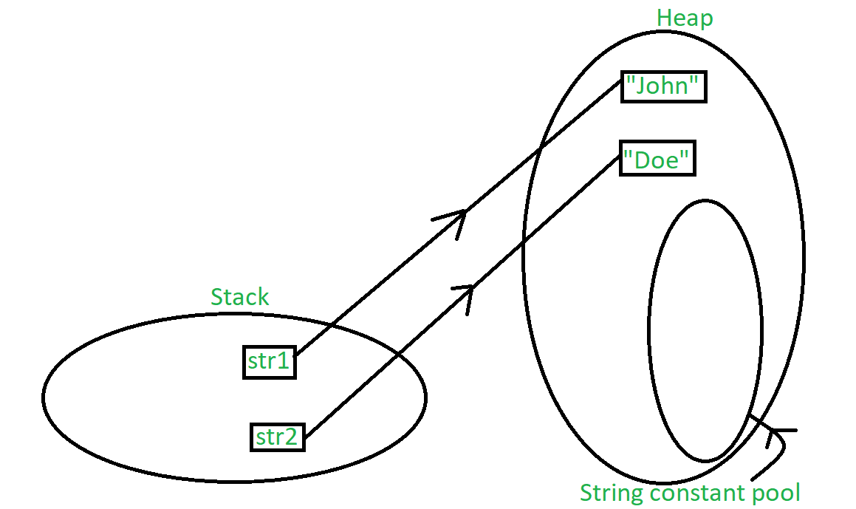
String
String str1 = new String(“John”);
String str2 = new String(“Doe”);

Slide 19
Why is String Immutable in Java?
The String is safe for multithreading because of its immutableness. Different threads can access a single "String instance". It removes the synchronization for thread safety because we make strings thread-safe implicitly.
If we don't make the String immutable, it will pose a serious security threat to the application. For example, database usernames, passwords are passed as strings to receive database connections. The String is immutable, so its value cannot be changed. If the String doesn't remain immutable, any hacker can cause a security issue in the application by changing the reference value.
The String pool cannot be possible if String is not immutable in Java. A lot of heap space is saved by JRE. The same string variable can be referred to by more than one string variable in the pool. String interning can also not be possible if the String would not be immutable.

Slide 20
Classes
In object-oriented programming , a class is a template definition of the method s and variable s in a particular kind of object . Thus, an object is a specific instance of a class; it contains real values instead of variables.
A class can have subclasses that can inherit all or some of the characteristics of the class. In relation to each subclass, the class becomes the superclass.
Subclasses can also define their own methods and variables that are not part of their superclass.

Slide 21
Objects
‘java.lang.Object’ is a super class of all Classes in java.
State: It is represented by attributes of an object. It also reflects the properties of an object.
Behavior: It is represented by methods of an object. It also reflects the response of an object with other objects.
Identity: It gives a unique name to an object and enables one object to interact with other objects.

Slide 22
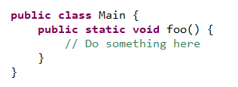
Functions
In Java, all function definitions must be inside classes. We also call functions methods.
static means this method belongs to the class Main and not to a specific instance of Main. Which means we can call the method from a different class like that Main.foo().
void means this method doesn't return a value. Methods can return a single value in Java and it must be defined in the method declaration. However, you can use return by itself to exit the method.
This method doesn't get any arguments, but of course Java methods can get arguments as we'll see further on.

Slide 23
Access Specifiers
Private: The access level of a private modifier is only within the class. It cannot be accessed from outside the class.
Default: The access level of a default modifier is only within the package. It cannot be accessed from outside the package. If you do not specify any access level, it will be the default.
Protected: The access level of a protected modifier is within the package and outside the package through child class. If you do not make the child class, it cannot be accessed from outside the package.
Public: The access level of a public modifier is everywhere. It can be accessed from within the class, outside the class, within the package and outside the package.

Slide 24
Access Specifiers
Access Modifier | Within Class | Within package | Outside package by subclass only | Outside package
Private | Y | N | N | N
Default | Y | Y | N | N
Protected | Y | Y | Y | N
Public | Y | Y | Y | Y

Slide 25
Static & Final
Static
Static Variables & Static Method.
Method & Variables marked are static belongs to the class in which they reside in.
Static variables and methods can be accessed using the class name followed by a dot and the name of the variable or method.
Final
A final variable can be explicitly initialized only once. A reference variable declared final can never be reassigned to refer to a different object.
However, the data within the object can be changed. So, the state of the object can be changed but not the reference.

Slide 26
Downsides of Java Language
Performance - Java programs take much longer time to run compared to C/C++.
Low level programming - There is no support for low level programming in Java, like pointers are missing.
Garbage collection - There is no control over garbage collection in Java. That is programmer does not have any right to control the garbage collection. Java does not provide functions like delete(), free().
Verbose – Java language is more verbose than modern languages like JavaScript & Python.

Slide 27
More to follow..

Slide 28
10-Jan-2023
Introduction
Oops & Loops
Collections Framework
Comparators & Exception Handing
Java Functional Streams
Design Patterns
Conditional Operation
Different types of loops
OOPS
  Abstraction
  Encapsulation
  Inheritance
  Polymorphism

Slide 29
Conditions
if
if, else
Nested if
if, else if, else
Switch

Slide 30
Conditional Operator (?:)
variable x = (condition) ? (value if true): (value if false)

Slide 31
Fundamentals of Oops
Inheritance
Polymorphism
Abstraction
Encapsulation

Slide 32
Encapsulation
Encapsulation is defined as the wrapping up of data under a single unit. It is the mechanism that binds together code and the data it manipulates.
The variables or data of a class is hidden from any other class and can be accessed only through any member function of its own class in which it is declared.
Encapsulation can be achieved by Declaring all the variables in the class as private and writing public methods in the class to set and get the values of variables.
Encapsulation is defined with the setter and getter methods.

Slide 33
Abstraction
Abstraction is a process of hiding the implementation details and showing only functionality to the user.
Abstract Class
Parent Class
Child Class 1
Child Class N

Slide 34
Abstraction
Normal Methods:
getName()
getCity()
isLoggedIn()
login()
logout()
Voice Agent
Chat Agent
Agent
Abstract Methods:
Supervisor
getType()
isSupervisor()
isVoiceAgent()
isChatAgent()

Slide 35
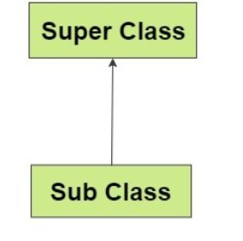
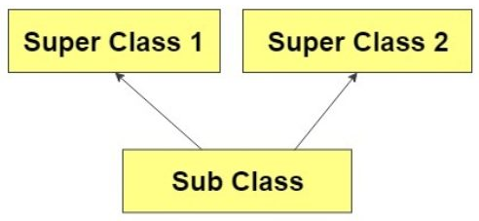
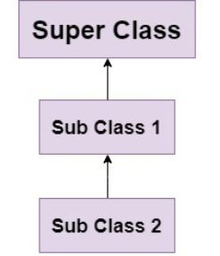
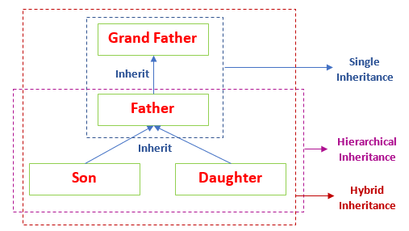
Inheritance
Single-level inheritance.
Multi-level Inheritance.
Hierarchical Inheritance.
Hybrid Inheritance.

Slide 36
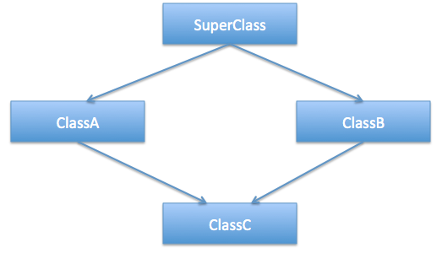
Multiple Inheritance
Java doesn’t support Multiple Inheritance to avoid the Diamond Problem.
Java uses Interfaces to support Multiple Inheritance behavior.

Slide 37
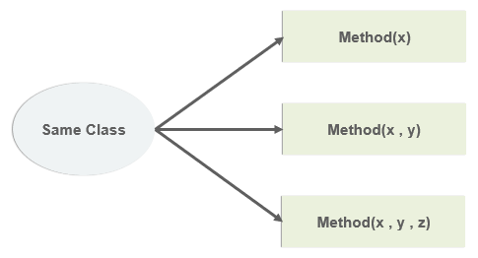
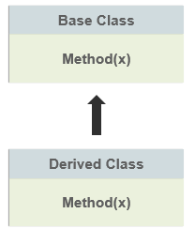
Polymorphism
Polymorphism is the ability of an object to take on many forms.
Compile-Time Polymorphism
Run-Time Polymorphism

Slide 38
Association
One to One
One to Many
Many to One
Many to Many

Slide 39
More to follow..

Slide 40
11-Jan-2023
Introduction
Oops & Loops
Collections Framework
Comparators & Exception Handing
Java Functional Streams
Design Patterns
Generics
Collections
Comparable vs Comparators
Inner Classes
Exception Handling

Slide 41
Generics
The Java Generics programming is introduced in JDK 5 to deal with type-safe objects.
It makes the code stable by detecting the bugs at compile time.
Type-safety: We can hold only a single type of objects in generics.
Type casting is not required: here is no need to typecast the object.
Compile-Time Checking: It is checked at compile time so problem will not occur at runtime. The good programming strategy says it is far better to handle the problem at compile time than runtime.

Slide 42
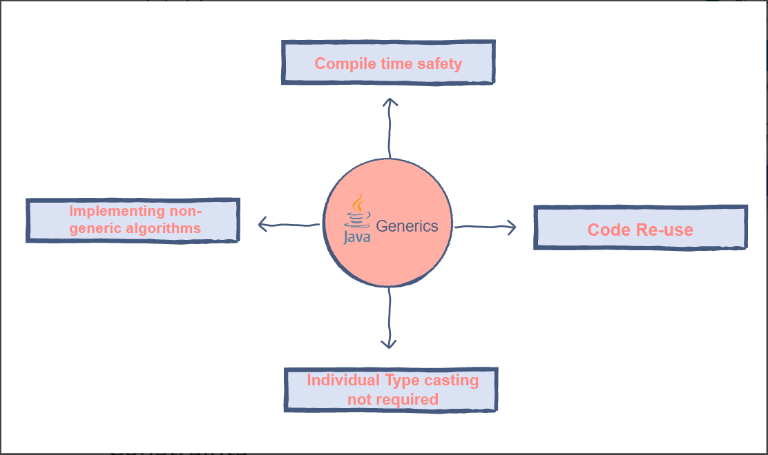
Generics

Slide 43
Collections - Interface
The Collection interface is a member of the Java Collections Framework.
It is a part of java.util package.
The Collection interface is not directly implemented by any class
However, it is implemented indirectly via its subtypes or sub interfaces like List, Map, and Set.

Slide 44
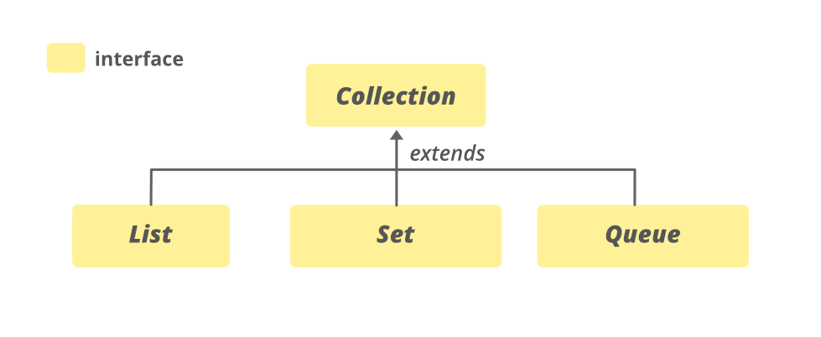
Collections - Interface

Slide 45
Lists
List is an interface whereas ArrayList is the implementation class of List.
It contains the index-based methods to insert, update, delete and search the elements.
The implementation classes of List interface are ArrayList, LinkedList, Stack and Vector.
The Array List and LinkedList are widely used in Java programming. The Vector class is deprecated since Java 5.

Slide 46
Maps
Map is a data structure that contains keys and values.
HashMap contains only unique keys.
HashMap may have one null key and multiple null values.
HashMap maintains no order.
The initial default capacity of Java HashMap class is 16 with a load factor of 0.75.
Java has various flavors of map: HashMap, TreeMap, LinkedHashMap, and Concurrent HashMap.

Slide 47
Sets
HashSet contains unique elements only.
HashSet allows null value.
HashSet doesn't maintain the insertion order. Here, elements are inserted based on their hash code algorithm.
HashSet is the best approach for search operations.
The Java platform contains three general-purpose Set implementations: HashSet , TreeSet , and LinkedHashSet.

Slide 48

HashSet*
Let’s See who you really are, HashSet.
HashMap*
HashMap!

Slide 49
Comparator vs Comparable
Comparable and Comparator both are interfaces and can be used to sort collection elements.
Comparator interface sort collection using two objects provided to it, whereas comparable interface compares" this" refers to the one objects provided to it.
Comparable provides single sorting sequence.
Whereas Comparator provides multiple sorting sequence.

Slide 50
Comparable
Comparable is an interface in java.
This interface imposes a total ordering on the objects of each class that implements it. This ordering is referred to as the class's natural ordering, and the class's compareTo method is referred to as its natural comparison method.
Lists (and arrays) of objects that implement this interface can be sorted automatically by Collections.sort (and Arrays.sort). Objects that implement this interface can be used as keys in a sorted map or as elements in a sorted set, without the need to specify a comparator.

Slide 51
Comparator
Comparators can be passed to a sort method (such as Collections.sort or Arrays.sort) to allow precise control over the sort order.
Comparators can also be used to control the order of certain data structures like TreeSet, TreeMap, PriorityQueue etc.

Slide 52
Inner Classes
The Java programming language allows you to define a class within another class. Such a class is called a nested class or inner class.
Why Use Nested Classes?
It is a way of logically grouping classes that are only used in one place:
It increases encapsulation
It can lead to more readable and maintainable code.

Slide 53
Anonymous Inner Classes
It is an inner class without a name and for which only a single object is created.
An anonymous inner class can be useful when making an instance of an object with certain “extras” such as overriding methods of a class or interface, without having to subclass a class.

Slide 54
Exception Handling
Exception is an unwanted or unexpected event, which occurs during the execution of a program, i.e., at run time, that disrupts the normal flow of the program’s instructions
Exception Handling in Java is one of the effective means to handle the runtime errors so that the regular flow of the application can be preserved.
Major reasons
Invalid user input, Device failures, Code errors.

Slide 55
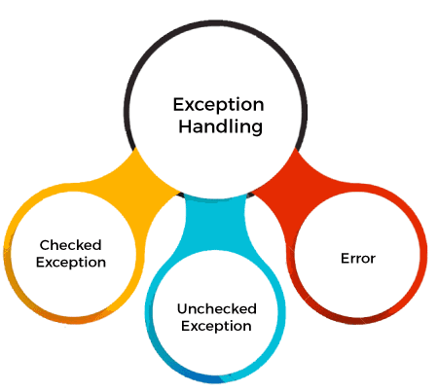
Exception Handling
Checked Exception
The classes that directly inherit the Throwable class except RuntimeException and Error are known as checked exceptions. For example, IOException, SQLException, etc. Checked exceptions are checked at compile-time.
Unchecked Exception
The classes that inherit the RuntimeException are known as unchecked exceptions. For example, ArithmeticException, NullPointerException, ArrayIndexOutOfBoundsException, etc. Unchecked exceptions are not checked at compile-time, but they are checked at runtime.

Slide 56
Exception Handling – Key Words
Keyword | Description
try | The "try" keyword is used to specify a block where we should place an exception code. It means we can't use try block alone. The try block must be followed by either catch or finally.
catch | The "catch" block is used to handle the exception. It must be preceded by try block which means we can't use catch block alone. It can be followed by finally block later.
finally | The "finally" block is used to execute the necessary code of the program. It is executed whether an exception is handled or not.
throw | The "throw" keyword is used to throw an exception.
throws | The "throws" keyword is used to declare exceptions. It specifies that there may occur an exception in the method. It doesn't throw an exception. It is always used with method signature.

Slide 57
Custom Exceptions
Java exceptions cover almost all the general type of exceptions that may occur in the programming. However, we sometimes need to create custom exceptions.
Business logic exceptions: These are the exceptions related to business logic and workflow. It is useful for the application users or the developers to understand the exact problem.

Slide 58
try-with-resources Statement
The try-with-resources statement is a try statement that declares one or more resources
The resources declared need to implement the AutoCloseable interface.
try (FileInputStream fin = new FileInputStream("./Sample.txt.txt")) {
byte bytes = 10;
while((bytes = (byte) fin.read()) > 0) {
System.out.print(bytes);
}
} catch(IOException ex) {
ex.printStackTrace();
}

Slide 59
More to follow..

Slide 60
12-Jan-2023
Introduction
Oops & Loops
Collections Framework
Comparators & Exception Handing
Java Functional Streams
Design Patterns
Functional Programming
Functional Interfaces
Lambdas over Ananymous Inner Classes
Java Streams

Slide 61
Functional Programming in Java
Benefits:
Declarative Approach
Higher Order Functions
No Side Effects
Streams

Slide 62
Functional Interfaces
A functional interface is an interface that contains only one abstract method
Functional Interface is additionally recognized as Single Abstract Method Interfaces i.e., SAM interfaces.
Functional interfaces are used and executed by representing the interface with an annotation called @FunctionalInterface.
However, they can include any quantity of default and static methods.

Slide 63
List of Functional Interfaces in Java
Consumer
Predicate
Function
Supplier
Bi-Consumer
Bi-Predicate
Bi-Function
Unary Operator
Binary Operator

Slide 64
Lambdas
Lambda expressions basically express instances of functional interfaces.
It saves a lot of boiler plate code.
In case of lambda expression, we don't need to define the method again for providing the implementation
Java lambda expression is treated as a function, so compiler does not create .class file.

Slide 65
Rules to Remember
The body of the lambda expression can be either a single expression or more statements.
If we are using a single expression as the body of a lambda expression, then no need to enclose the body with curly braces ({}).
If we are using one or more statements as the body of a lambda expression, then enclosing them within curly braces({}) can be mandatory.
If we are using one or more statements as the body of a lambda expression, then the return keyword is mandatory.

Slide 66
A Quote to Remember
Two Lines of Code is too much for Lambda.

Slide 67
Streams
Sequence of elements − A stream provides a set of elements of specific type in a sequential manner. A stream gets/computes elements on demand. It never stores the elements.
Aggregate operations − Stream supports aggregate operations like filter, map, limit, reduce, find, match, and so on.
Pipelining − Most of the stream operations return stream itself so that their result can be pipelined. These operations are called intermediate operations and their function is to take input, process them, and return output to the target.
Automatic iterations − Stream operations do the iterations internally over the source elements provided, in contrast to Collections where explicit iteration is required.

Slide 68
Imperative vs Declarative Programming
Imperative
  With imperative programming, you tell the compiler what you want to happen, step by step.
  Less Readable & More Complex.
  The code structure can be long and complex.
Declarative
  With declarative programming, on the other hand, you write code that describes what you want, but not necessarily how to get it.
  More Readable and less complex.
  The code structure can be concise and less complex.

Slide 69
Higher Order Functions
Higher-order functions are functions that either accept other functions as arguments or return a function as a result.
They provide simplicity to the code, allowing the programmer and any other party to understand the code at a high level easily.

Slide 70
Method Reference
Method reference is the way in a lambda expression to refer a method without executing it. In the body of a lambda expression, we can able to call another method if they are compatible with a functional interface.
The operator "::" can be used to separate the class name from the method name.

Slide 71
Immutability
Data won’t change behind our backs.
No hidden side effects.

Slide 72
More to follow..

Slide 73
13-Jan-2023
Introduction
Oops & Loops
Collections Framework
Comparators & Exception Handing
Java Functional Streams
Design Patterns
Threads
Parallel Streams
Synchronization
Design Patterns
  Singleton
  Builder
  Factory

Slide 74
Threads
A thread in Java is the direction or path that is taken while a program is being executed.
Two types of creation of threads:
Extending java.lang.Thread class
Implementing Runnable interface

Slide 75
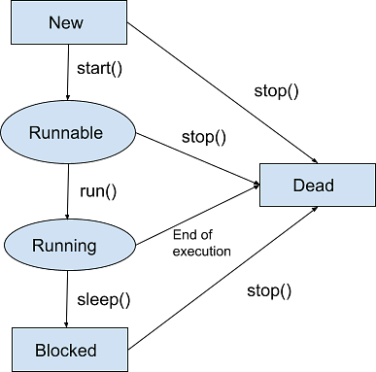
Thread Life Cycle
New
Runnable
Running
Blocked (Non-runnable state)
Dead

Slide 76
Synchronization
Synchronization in Java is the process that allows only one thread at a particular time to complete a given task entirely.
Synchronization can be achieved in 3 ways:
Synchronized Method
Synchronized Block
Static Synchronization

Slide 77
Parallel Streams
By default, any stream operation in Java is processed sequentially, unless explicitly specified as parallel.
The output of this sequential stream is predictable. The list elements will always be printed in an ordered sequence.
Parallel streams enable us to execute code in parallel on separate cores. The final result is the combination of each individual outcome.
However, the order of execution is out of our control. It may change every time the program has been executed.

Slide 78
Design Pattern
A design pattern is a well-described solution to a common software problem.
Using design patterns promotes reusability that leads to more robust and highly maintainable code.
Some familiar design patterns:
Singleton
Factory
Builder

Slide 79
Singleton
Singleton pattern restricts the instantiation of a class and ensures that only one instance of the class exists in the JVM.
The singleton class must provide a global access point to get the instance of the class.
Different types of implementation:
Eager initialization
Static block initialization
Lazy Initialization
Thread Safe Singleton
Double Check

Slide 80
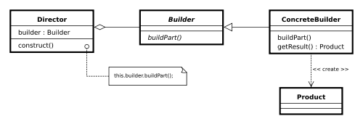
Builder
The builder pattern is a design pattern that allows for the step-by-step creation of complex objects using the correct sequence of actions. The construction is controlled by a director object that only needs to know the type of object it is to create.
Builder pattern aims to “Separate the construction of a complex object from its representation so that the same construction process can create multiple different representations.”
Builder pattern helps us in creating immutable classes with a large set of state attributes.

Slide 81
Factory
The factory design pattern is used when we have a superclass with multiple sub-classes and based on input, we need to return one of the sub-class.
The thumb rule of the factory design pattern says that define an interface for creating object and let the subclasses decide which class to instantiate.
This pattern takes out the responsibility of the instantiation of a class from the client program to the factory class.
It promotes loose-coupling of the code.

Slide 82
Coming soon..
Phase 2

Slide 83
Feedback?

Slide 84
Thank you

